Slide 1
Landover Hills Ward Distribution
Abdul Rehman Galsulkar, Fatma Fadlelmola, Shahdad Parsi, and
Yifeng Chen
Notes:
Fatma

Slide 2
Team Roles
Fatma Fadlelmola | Documentation and Visualization Manager
Abdul Rehman Galsulkar | Data Analyst and Manager
Shahdad Parsi | Communication Specialist
Yifeng Chen | Quality Assurance Specialist
Notes:
Fatma

Slide 3
Table of contents
01
02
03
04
05
06
Project Context
Deliverables
Project Requirements
Visualization
Challenges
Future Recommendations
Notes:
Fatma

Slide 4
01
Project Context

Slide 5
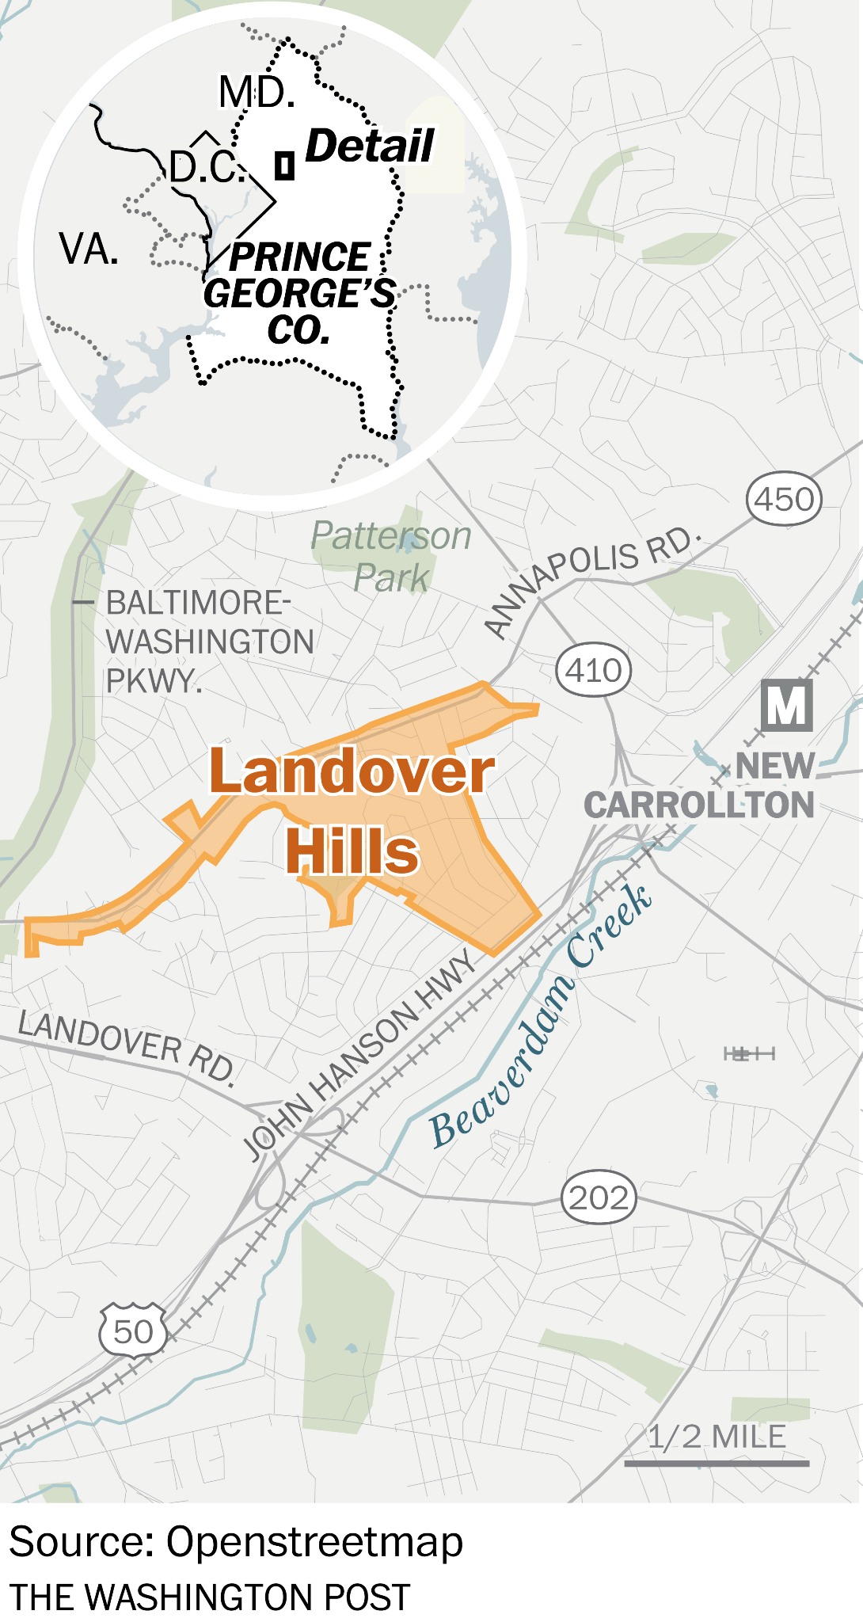

Client: Landover Hills
The town of Landover Hills is located in PG County, right off I-495
As of 2020, the population is 1,815
Median Household Income: $73,750
Employment Rate: 62.6%
As of 2024, there are 923 registered voters
Notes:
Shahdad

Slide 6
02
Deliverables

Slide 7
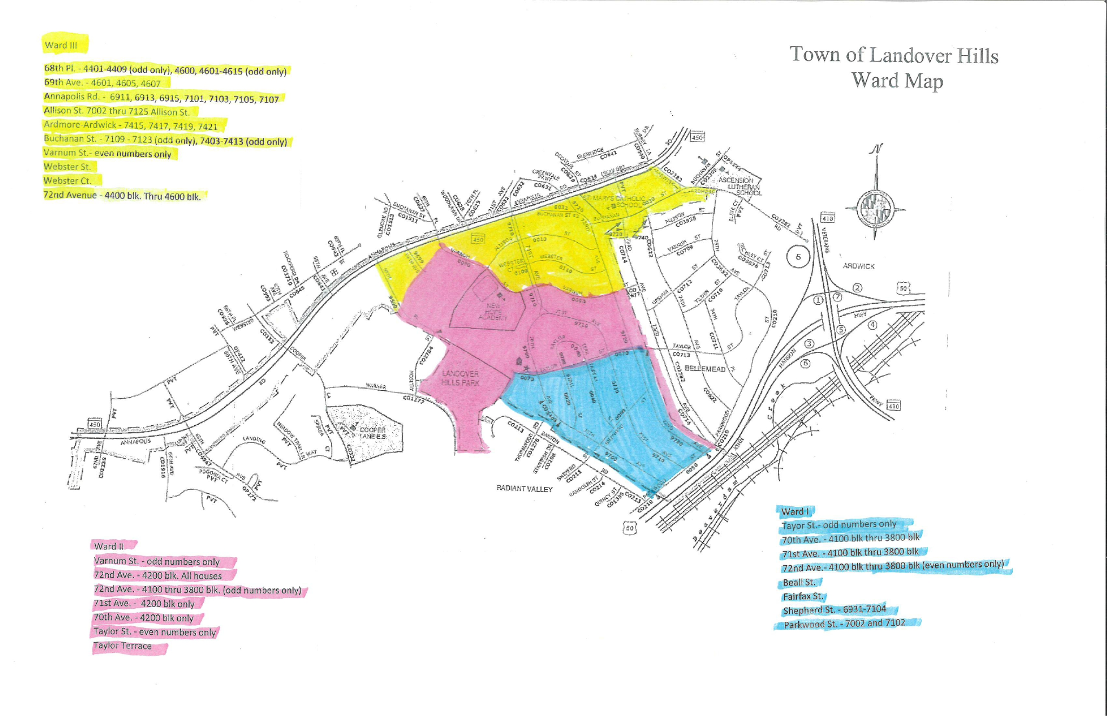
Project Deliverables
Three New Ward Maps
Analysis Reports of Voters
Project Documents/Datasheets
Client Requirements Document

Slide 8
03
Project Requirements

Slide 9
Project Requirements
Clean and standardize the dataset of registered voters in Landover Hills
Analyze the data to determine target ward populations
Redraw ward boundaries based on voter proximity and population
Develop further visualizations for the town Mayor
Notes:
Fatma

Slide 10
04
Visualization

Slide 11
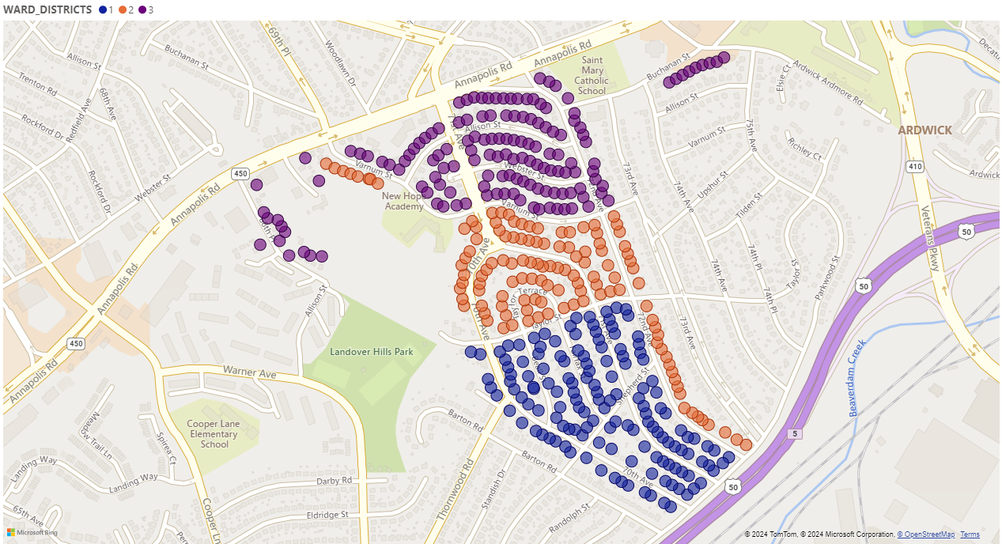
Original Ward Map
Ward 1 (Blue): 338
Ward 2 (Orange): 269
Ward 3 (Purple): 316

Slide 12
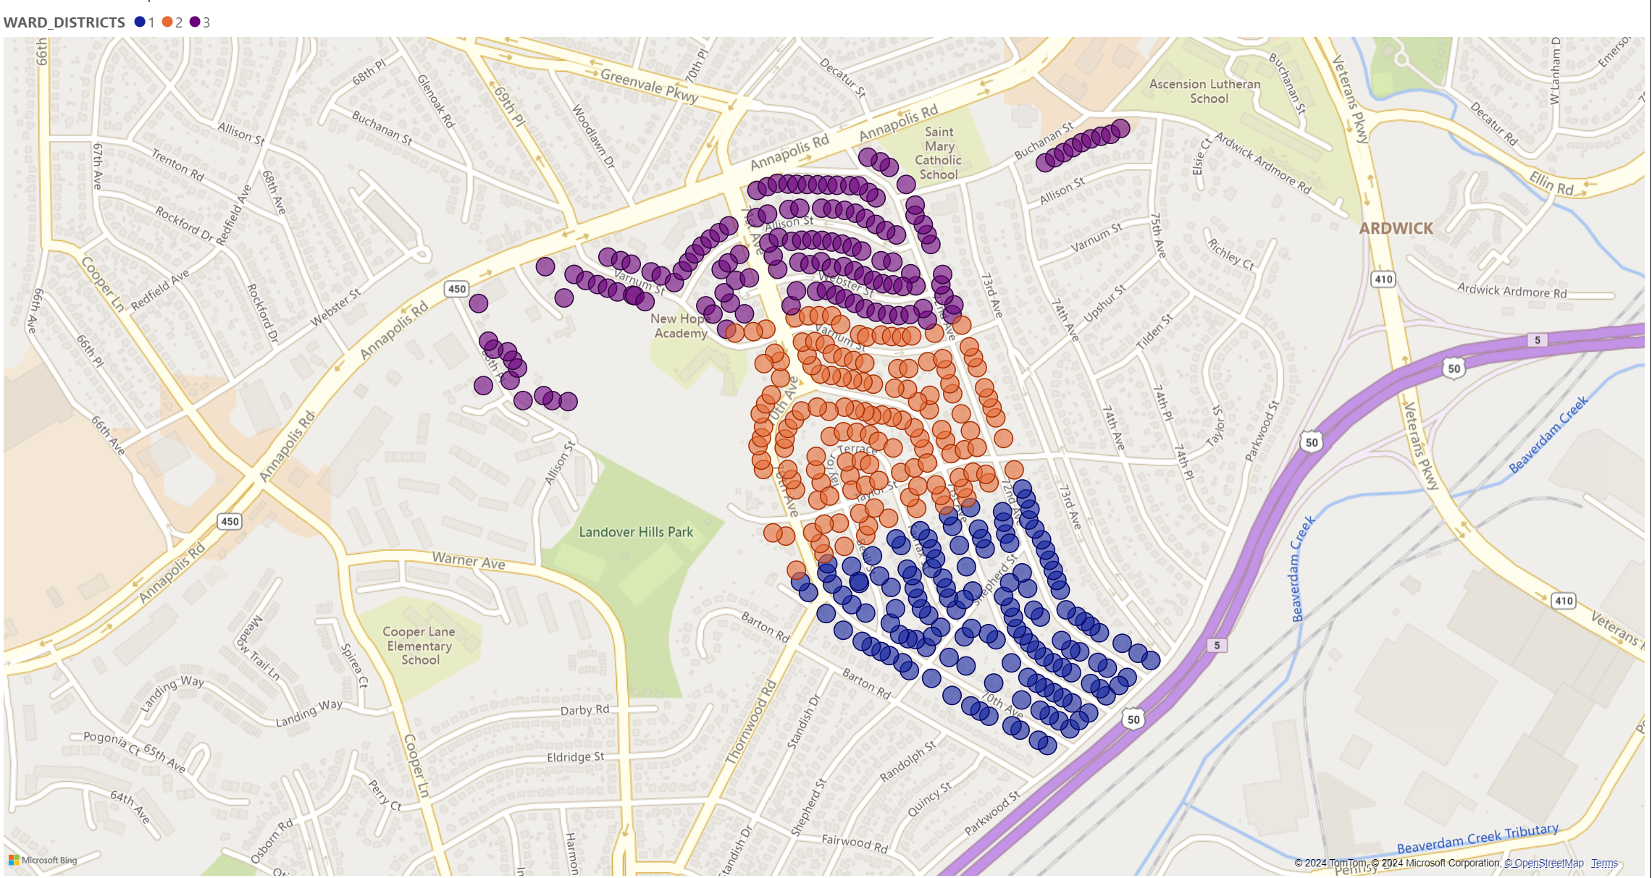
Ward Map #1
Ward 1 (Blue): 308
Ward 2 (Orange): 308
Ward 3 (Purple): 307

Slide 13
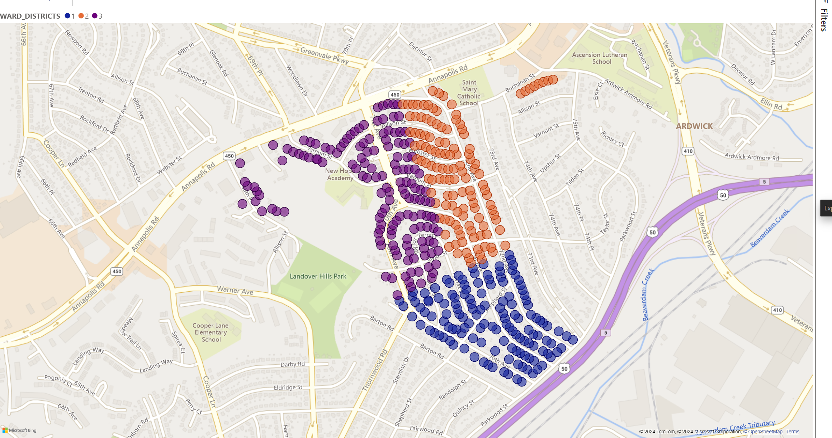
Ward Map #2
Ward 1 (Blue): 311
Ward 2 (Orange): 285
Ward 3 (Purple): 323
Notes:
Shahdad

Slide 14
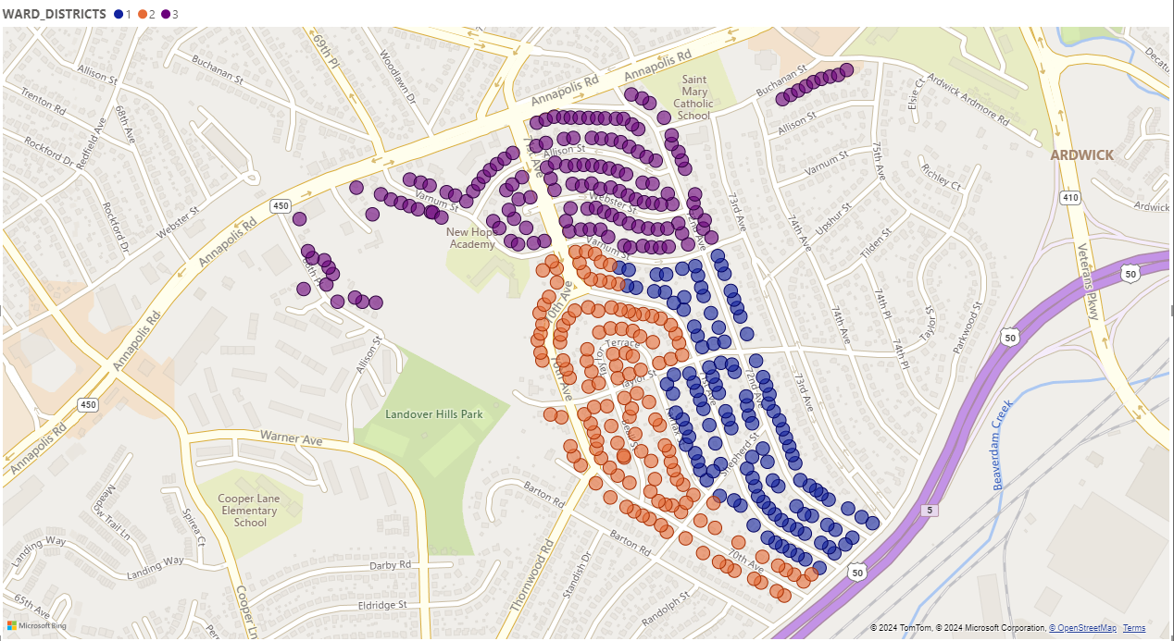
Ward Map #3
Ward 1 (Blue): 293
Ward 2 (Orange): 292
Ward 3 (Purple): 338

Slide 15
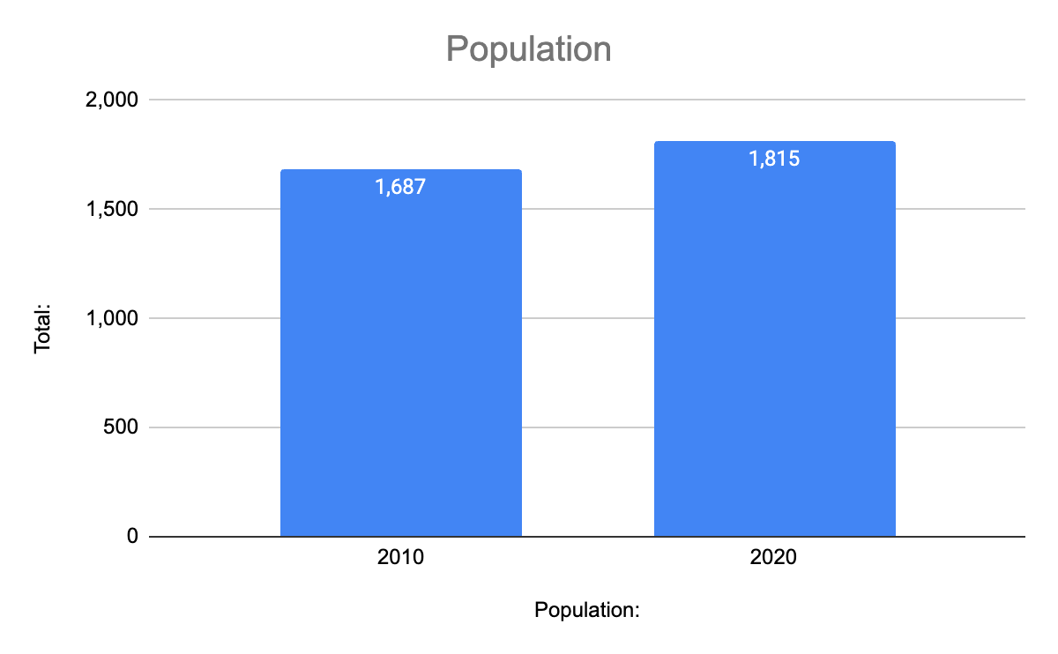
Population
Notes:
Shahdad

Slide 16
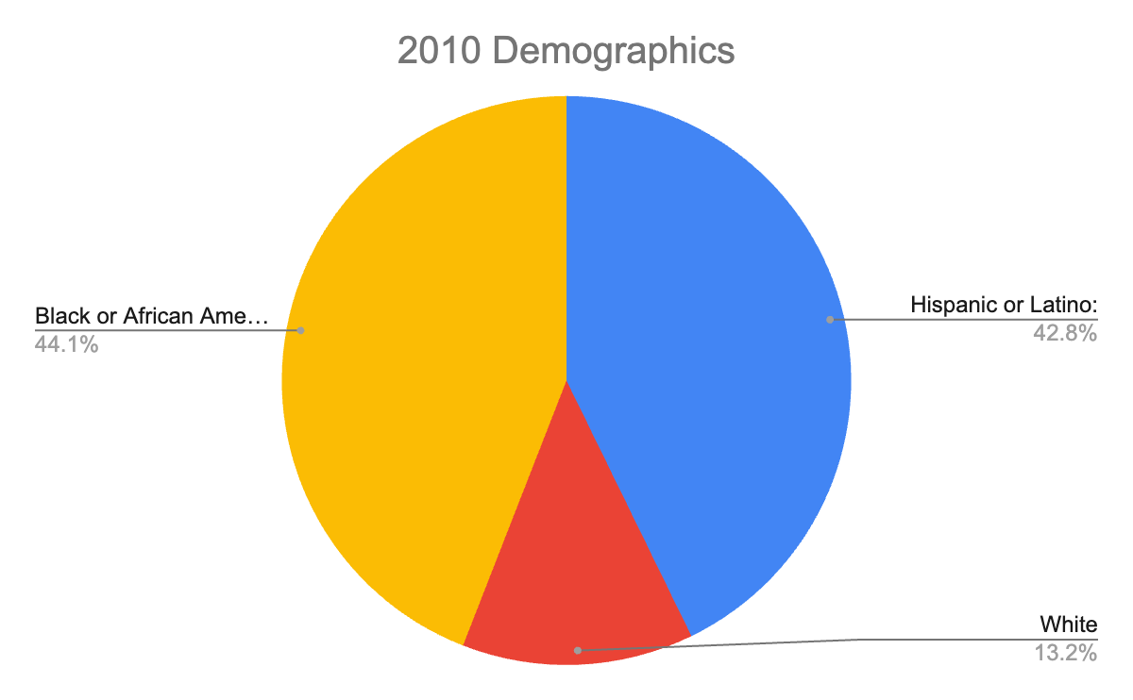
Race Demographic (2010)
Notes:
Shahdad

Slide 17
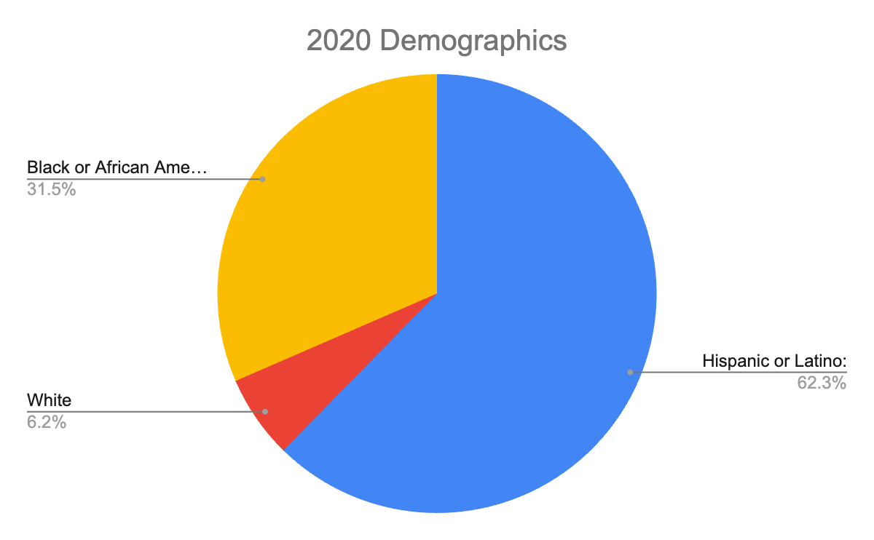
Race Demographic (2020)
Notes:
Shahdad

Slide 18
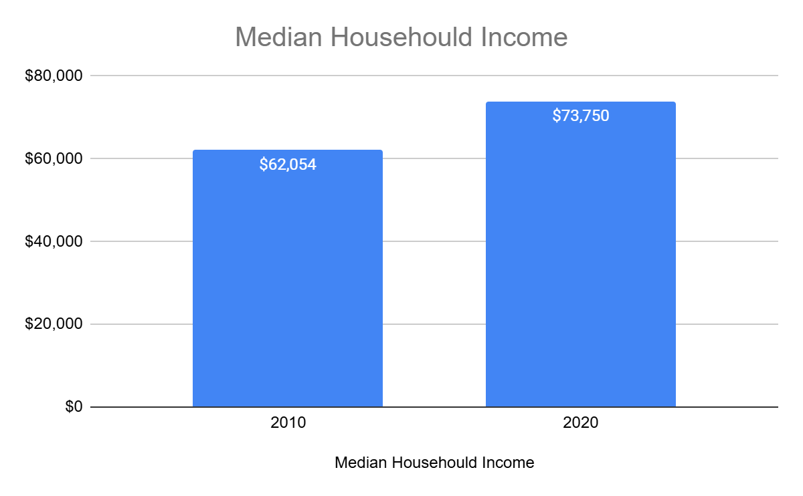
Income
Notes:
Shahdad

Slide 19
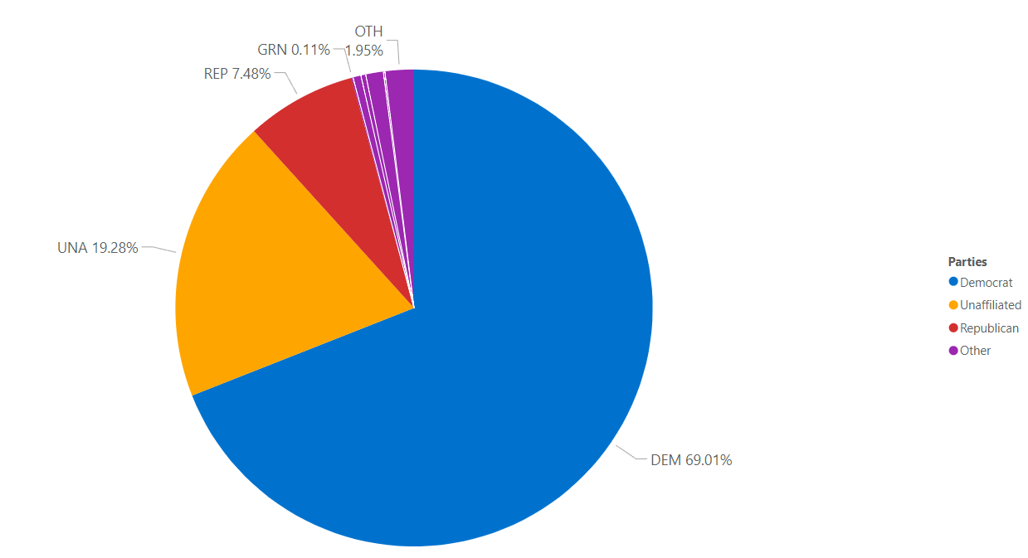
Voter Distribution by Party

Slide 20
05
Challenges

Slide 21
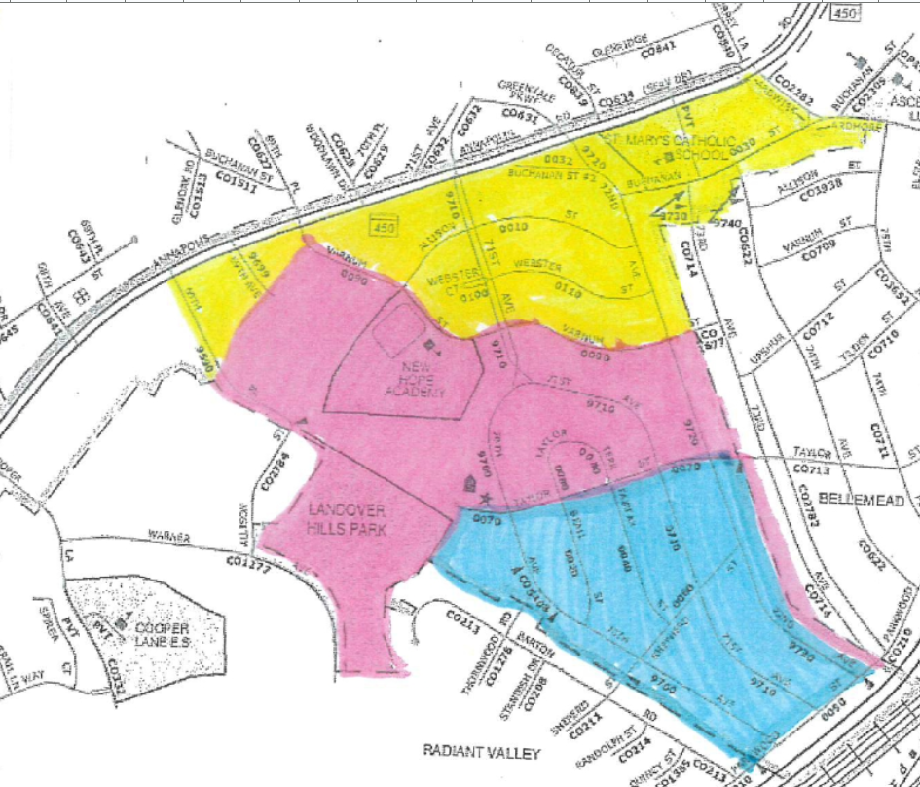
Challenges
Unregistration Population Impact
Not having 100% of population as registered voters impacted the accuracy of the analysis as well as the equal distribution of the wards.
Geographical Barriers
The original boundary lines were unique to the geographical
shape of Landover Hills, resulting in the need for more creative
solutions to creating new and unique boundary lines
Data Quantity
The uneven distributions of registered voters in total made it
challenging to create a numerically even three way split of the
ward lines
Notes:
Fatma

Slide 22
Technical Tools
Microsoft Excel & Google Sheets
Used to create our datasheets from the data given to us from our client. Able to reshape our data into newer wards to be used to create our visualizations.
OpenRefine
Used text facets to group and count the number of individuals in each ward and identify any outliers or inconsistencies in the data, ensuring it was clean and ready for visualization.
Power BI
Used to visualize our datasets and to visualize how we wish our new ward maps to look like.

Slide 23
06
Future Recommendations

Slide 24
Future Recommendations
Check for any discrepancies in future datasets while cleaning it
Continue to use voter registration data, check in on the towns population growth trends and projections
Consider splitting the town into four wards

Slide 25
Thank You!
Any Questions?

